Slide 1
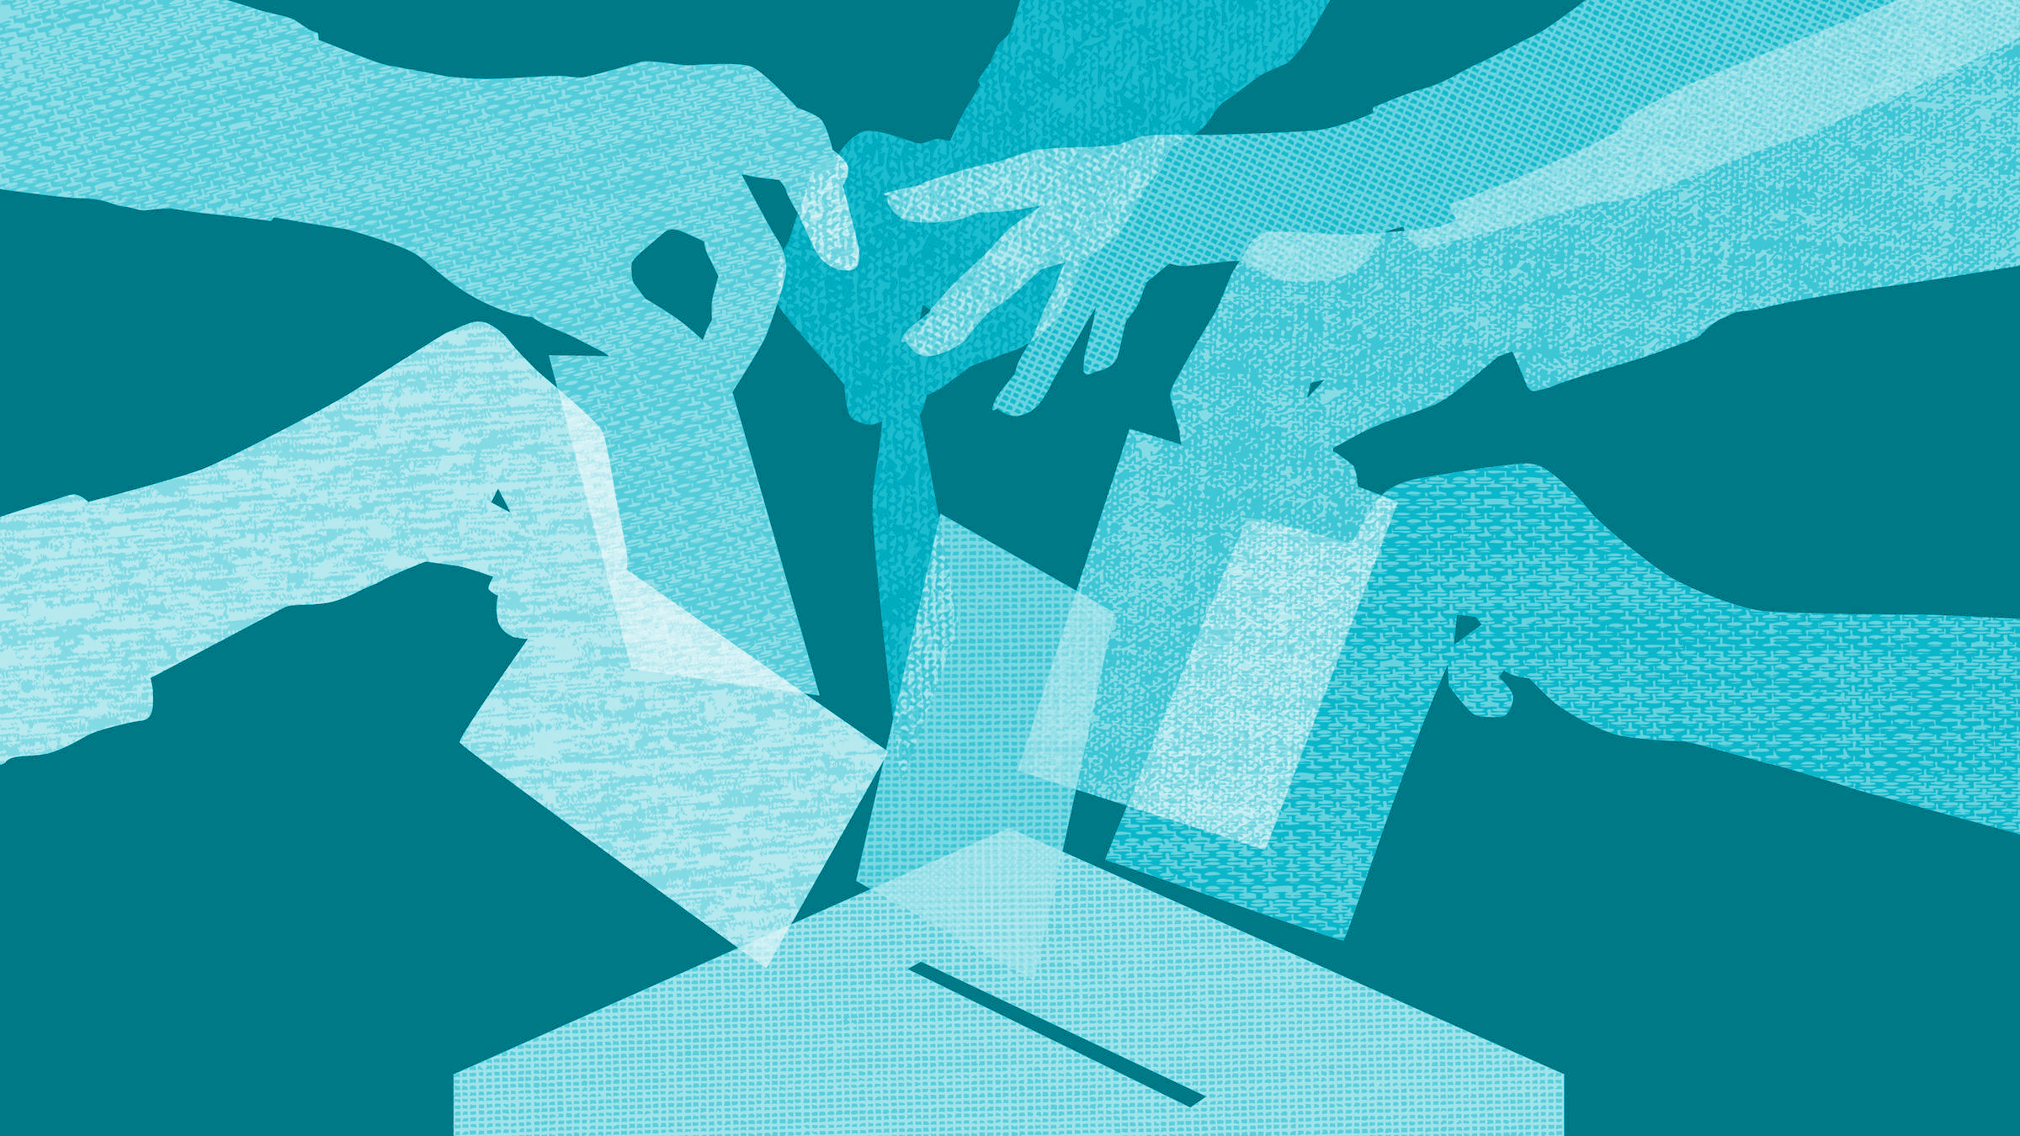

Digital Democracy:
Needfinding
Team Generation-G
Garrick F. | Gen S. | Grace W.

Slide 2
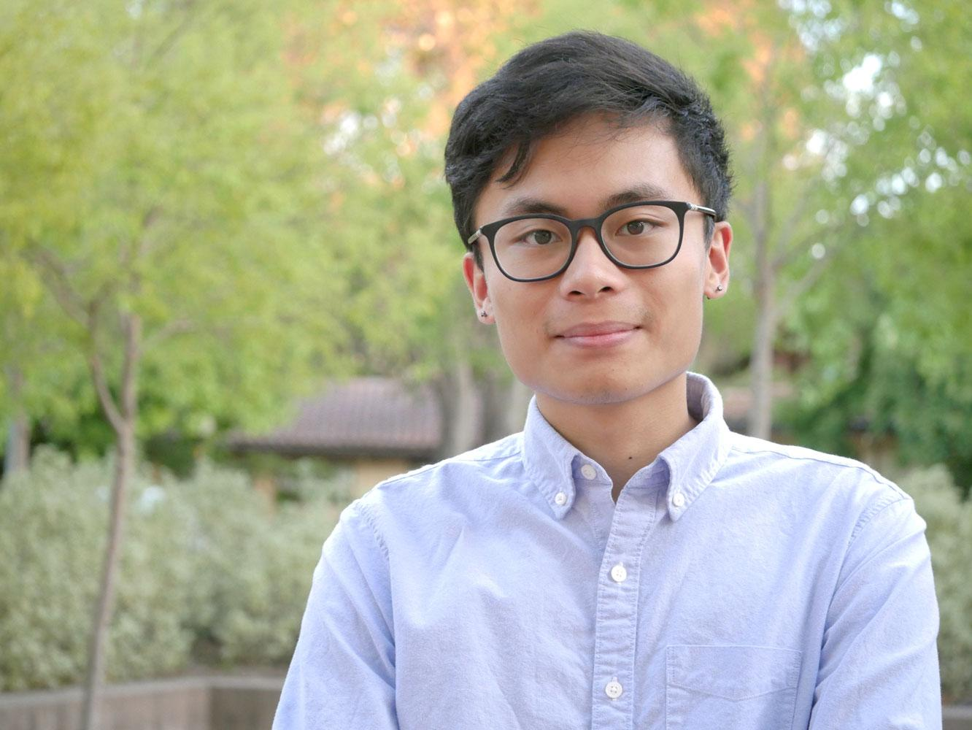
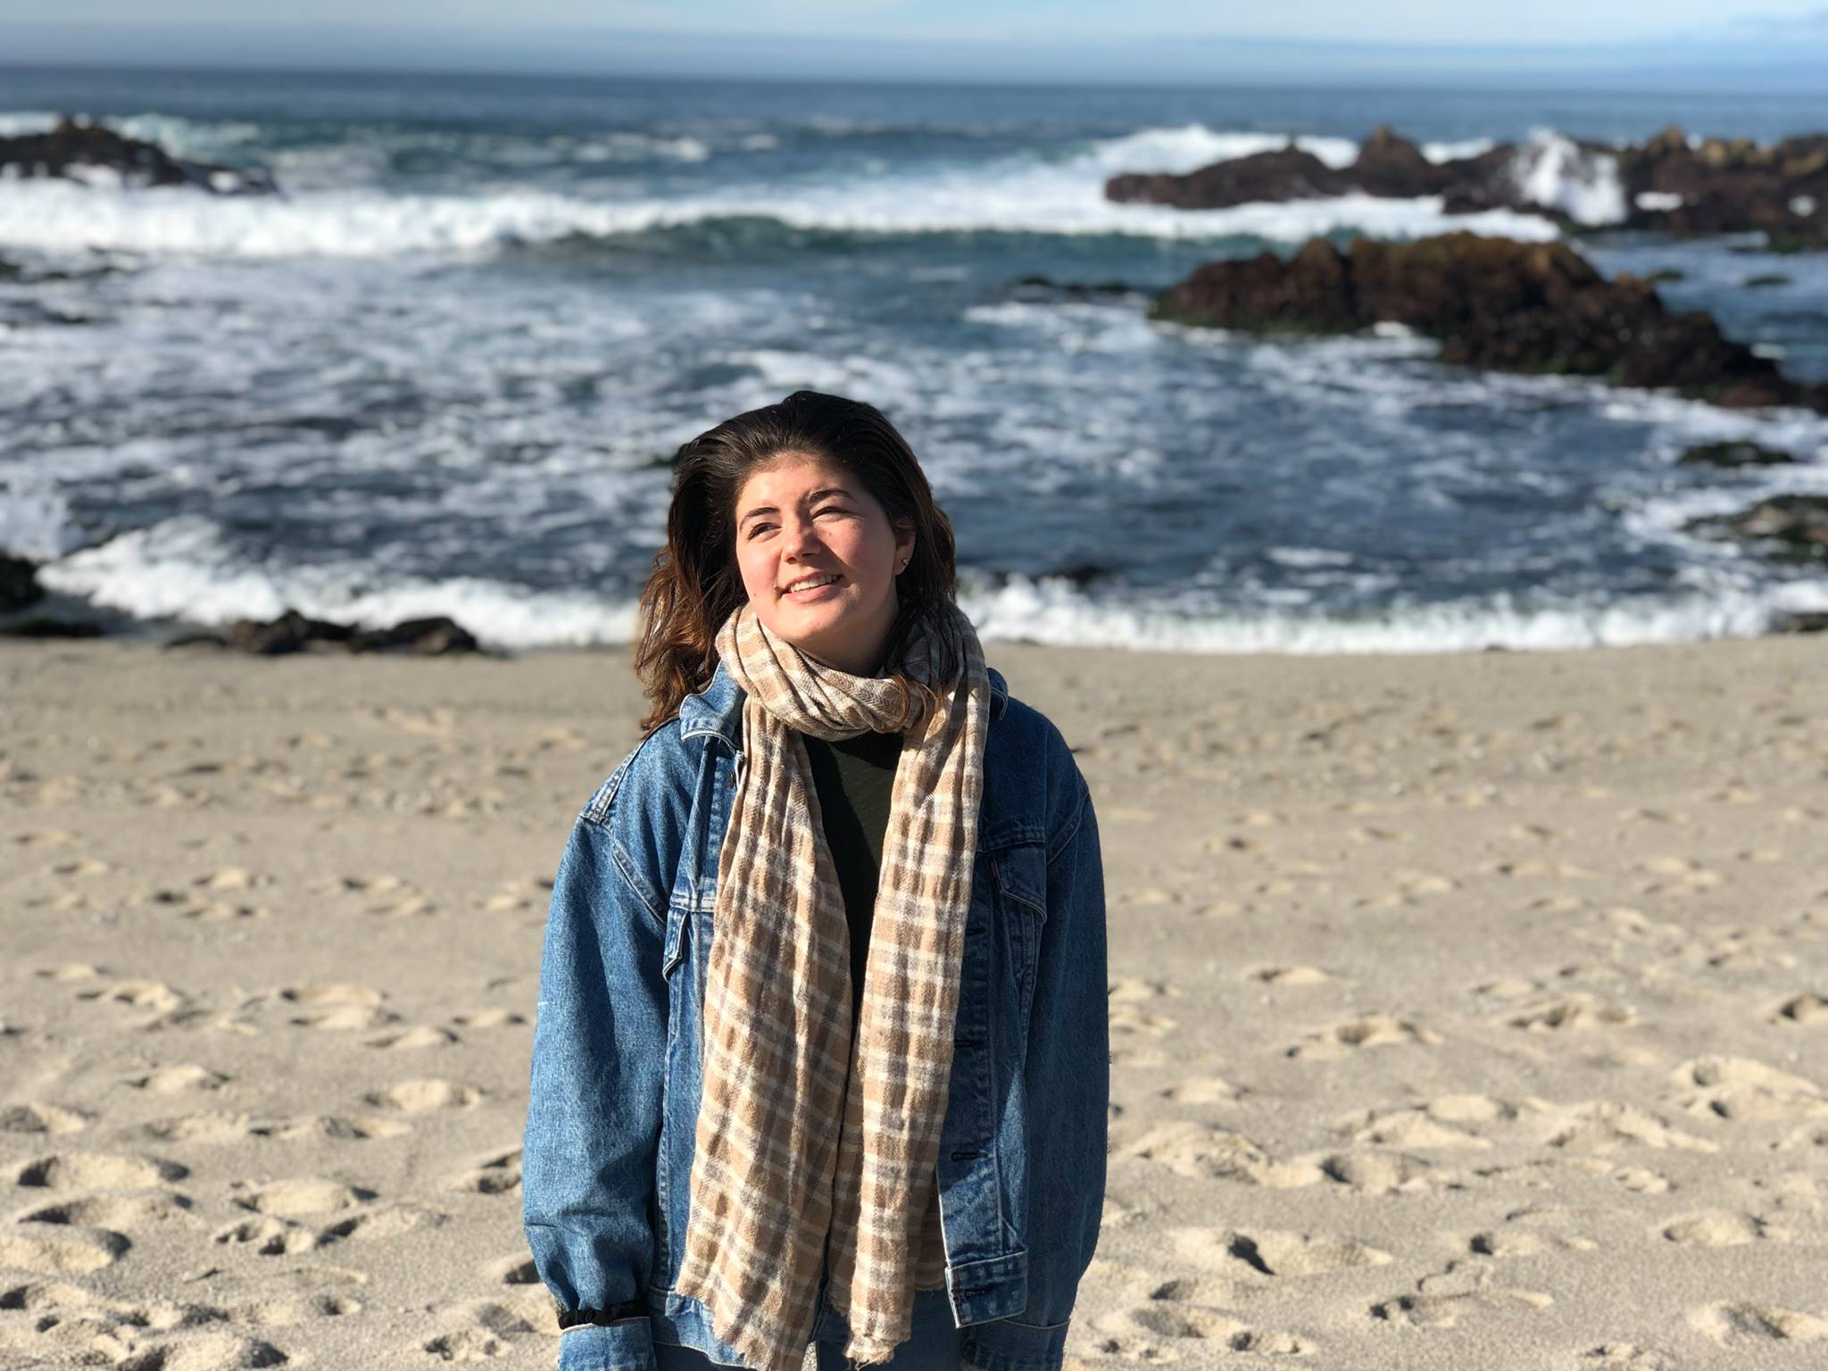
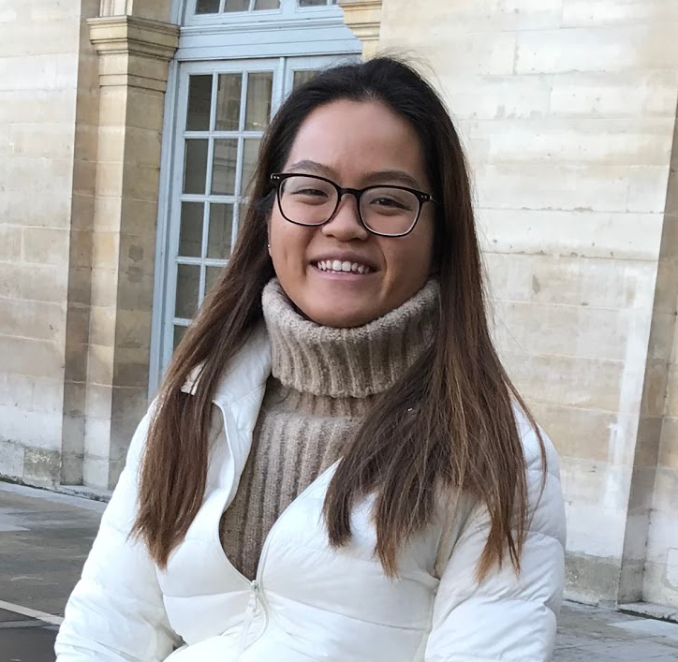
Garrick
Gen
Grace
Coterm, CompSci
will graduate soon
Senior, SymSys
funnier in person
Senior, Econ
still plays tetris
Mission
We are looking to solve problems in the digital democracy space (news consumption or discussion).

Slide 3




Needfinding Methodology
Who?
Recent college grad, i.e. 20-30 age range
Why?
Most interested in targeting this audience
How?
Solicited 15–20 min. interviews on views re: democracy
Where?
Downtown Palo Alto

Slide 4
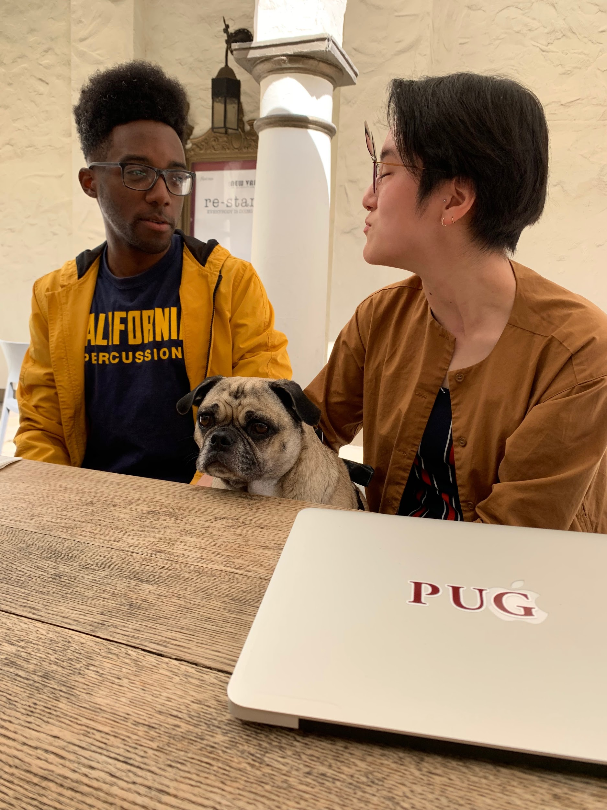
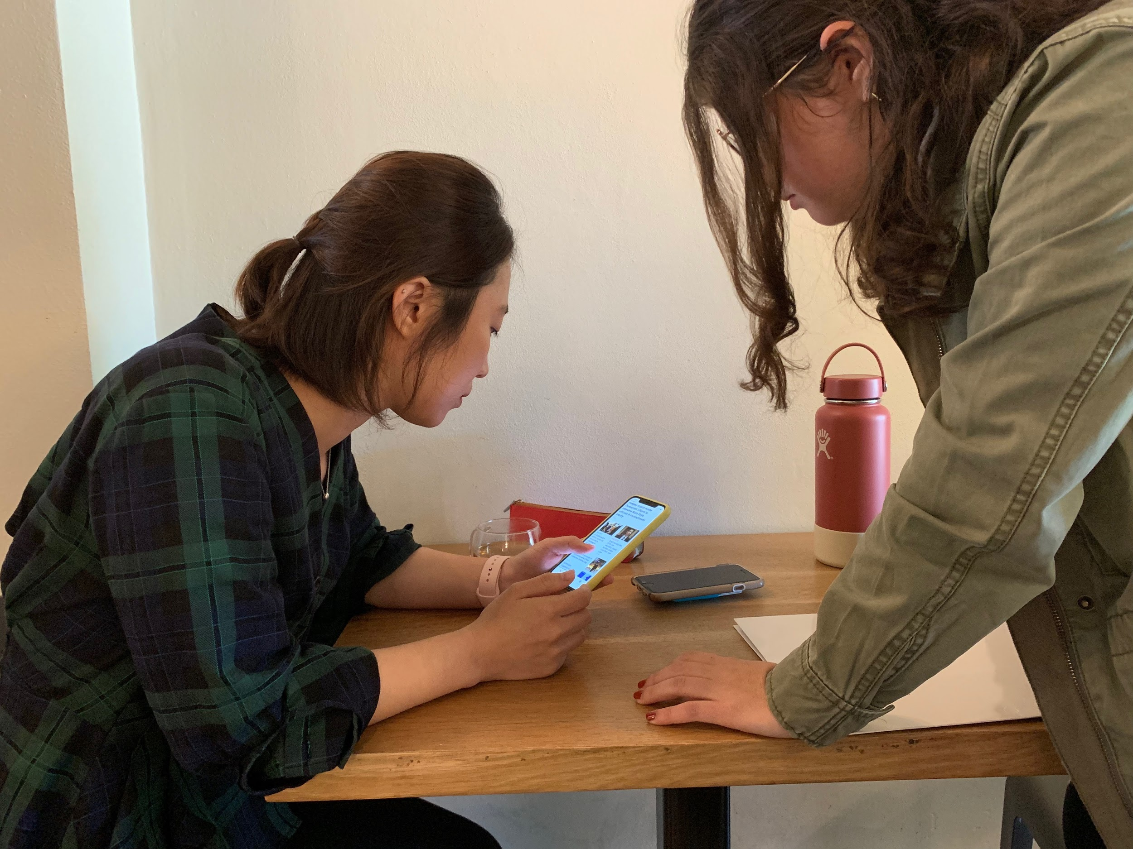
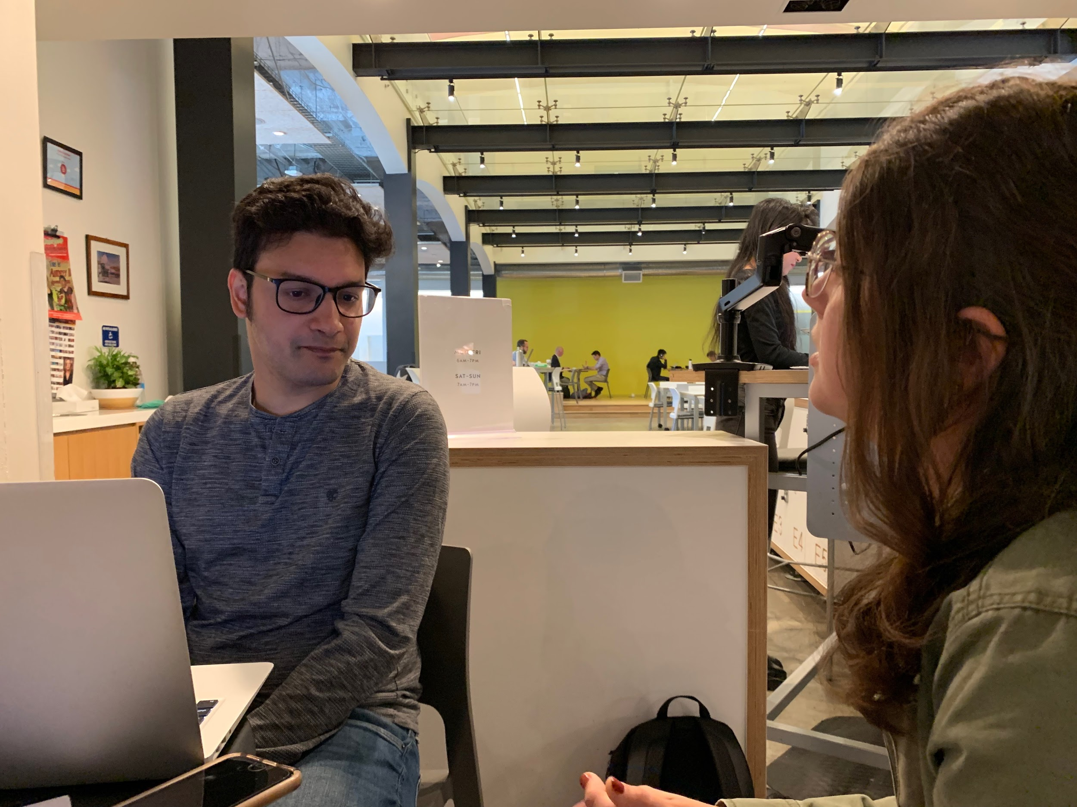
We found:
2 M | 2 F (& 1 dog)
~21-29 y.o.
College, to out of college, to working on Ph.D.
K
S
M
🐶
I

Slide 5
Discussion Guide
EXAMPLE Q’S
Walk me through the last time you voted.
What is the last headline you remember? 📱💻
How do you inform yourself politically?
THEMES
Voting behavior
News consumption
Interpersonal discussions about politics
Involvement in politics

Slide 6
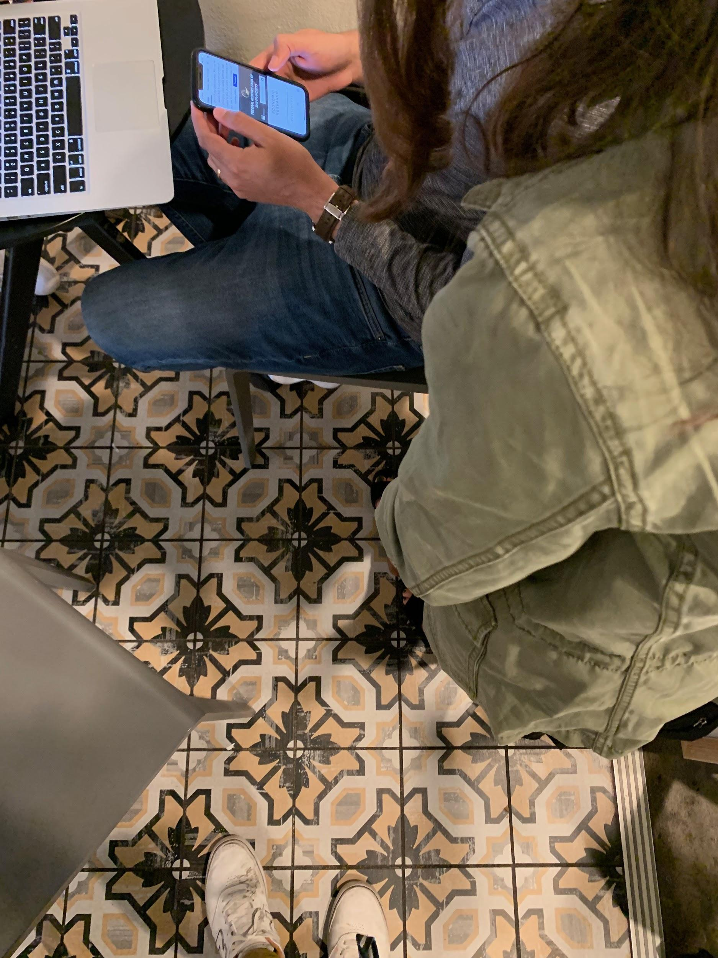
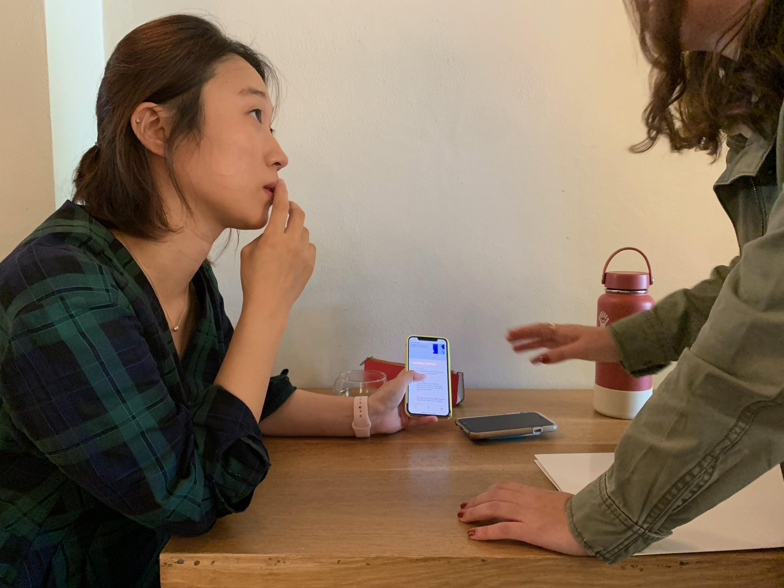

Slide 7
Interview Results
(Some threads we dug at…)

Slide 8
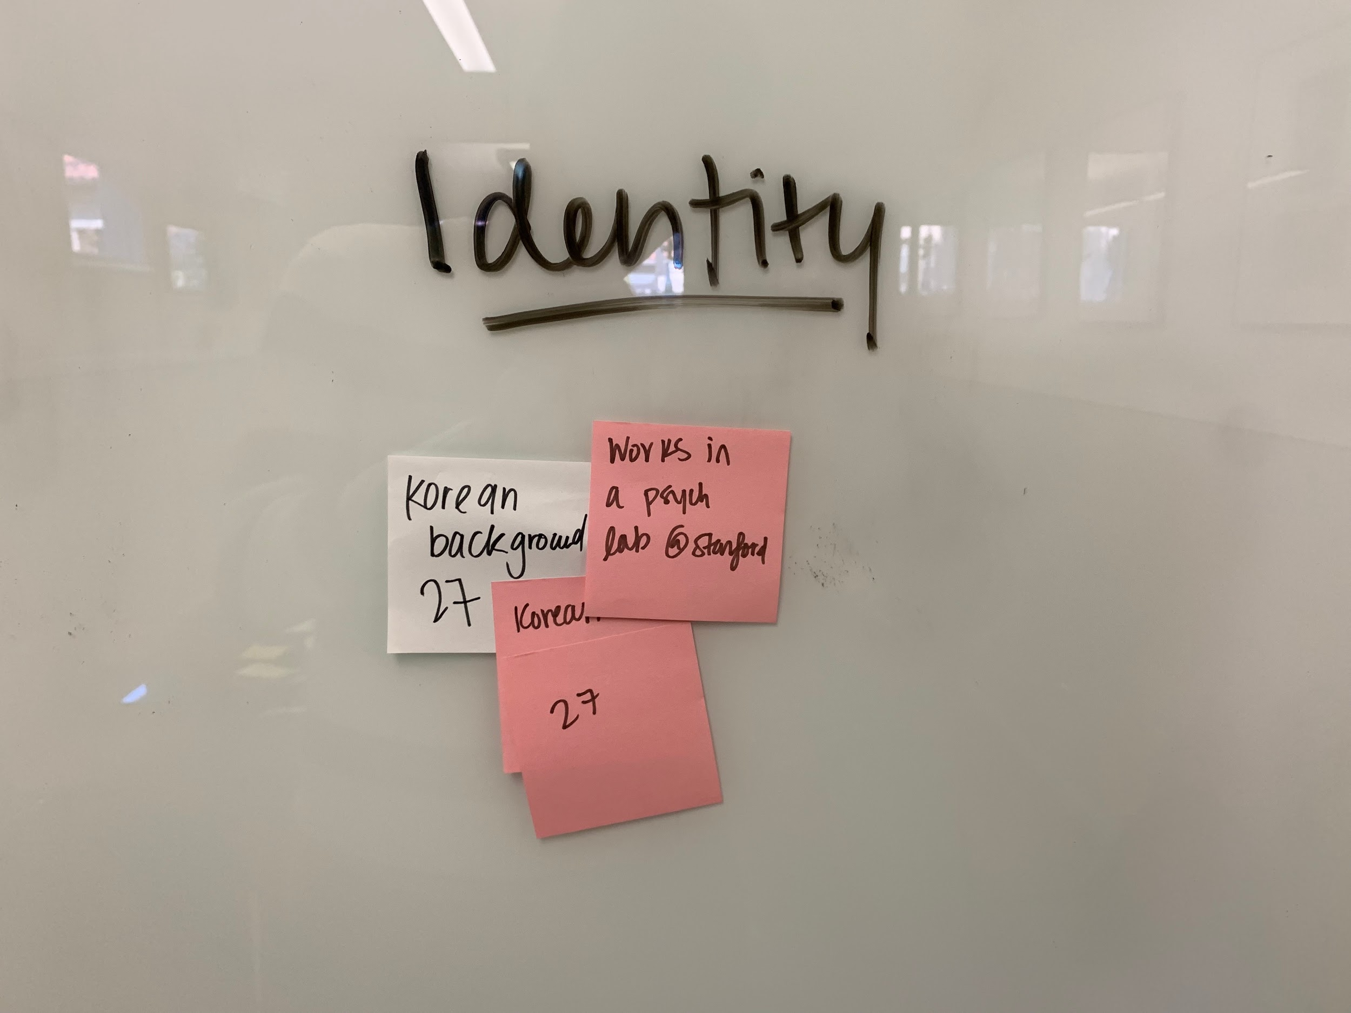
Finding interesting news...
[Why pick an article on Trump?] “There's no like specific reason, but I just want to know how the world is going day-to-day and found he is kind of, like, an issue maker.”
M
F, 27, Korean
Works in psych lab

Slide 9
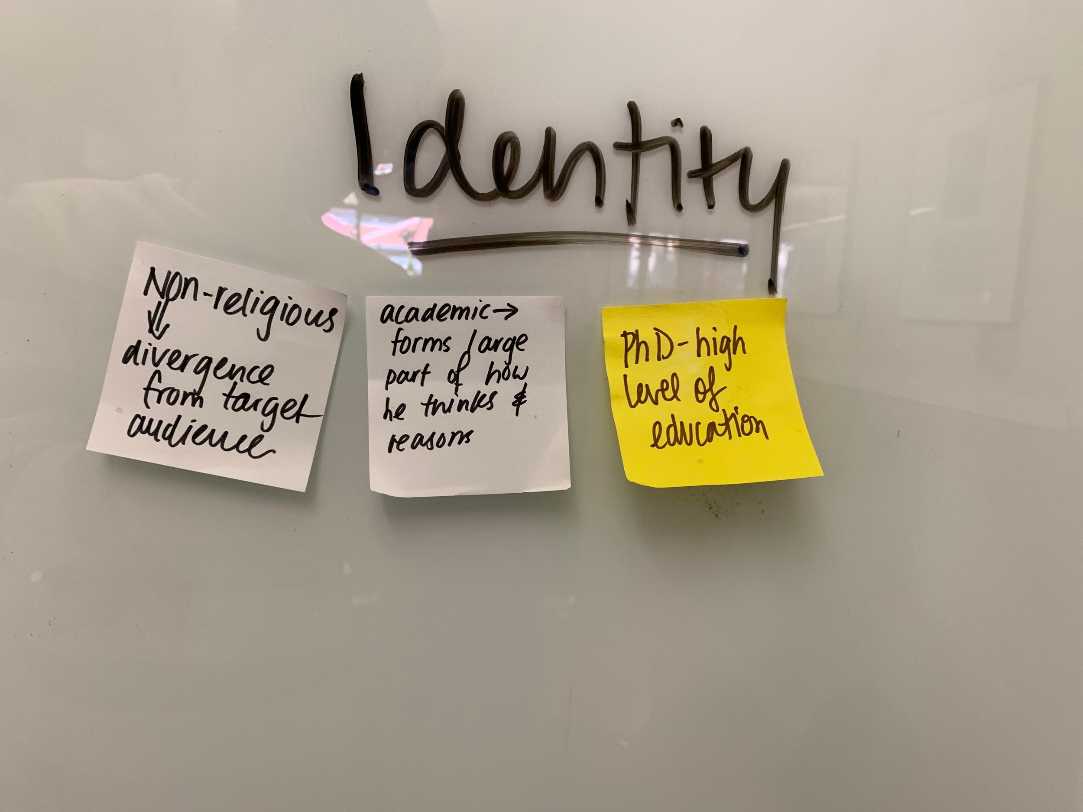
M, Indian
Getting Ph.D. in Economics
“We decided this was the time to go for a change, and personally I decided to vote against communism and vote...it turned out that was not the better option, but at the moment, it felt like a change was required.”
I
Moved to vote when...

Slide 10
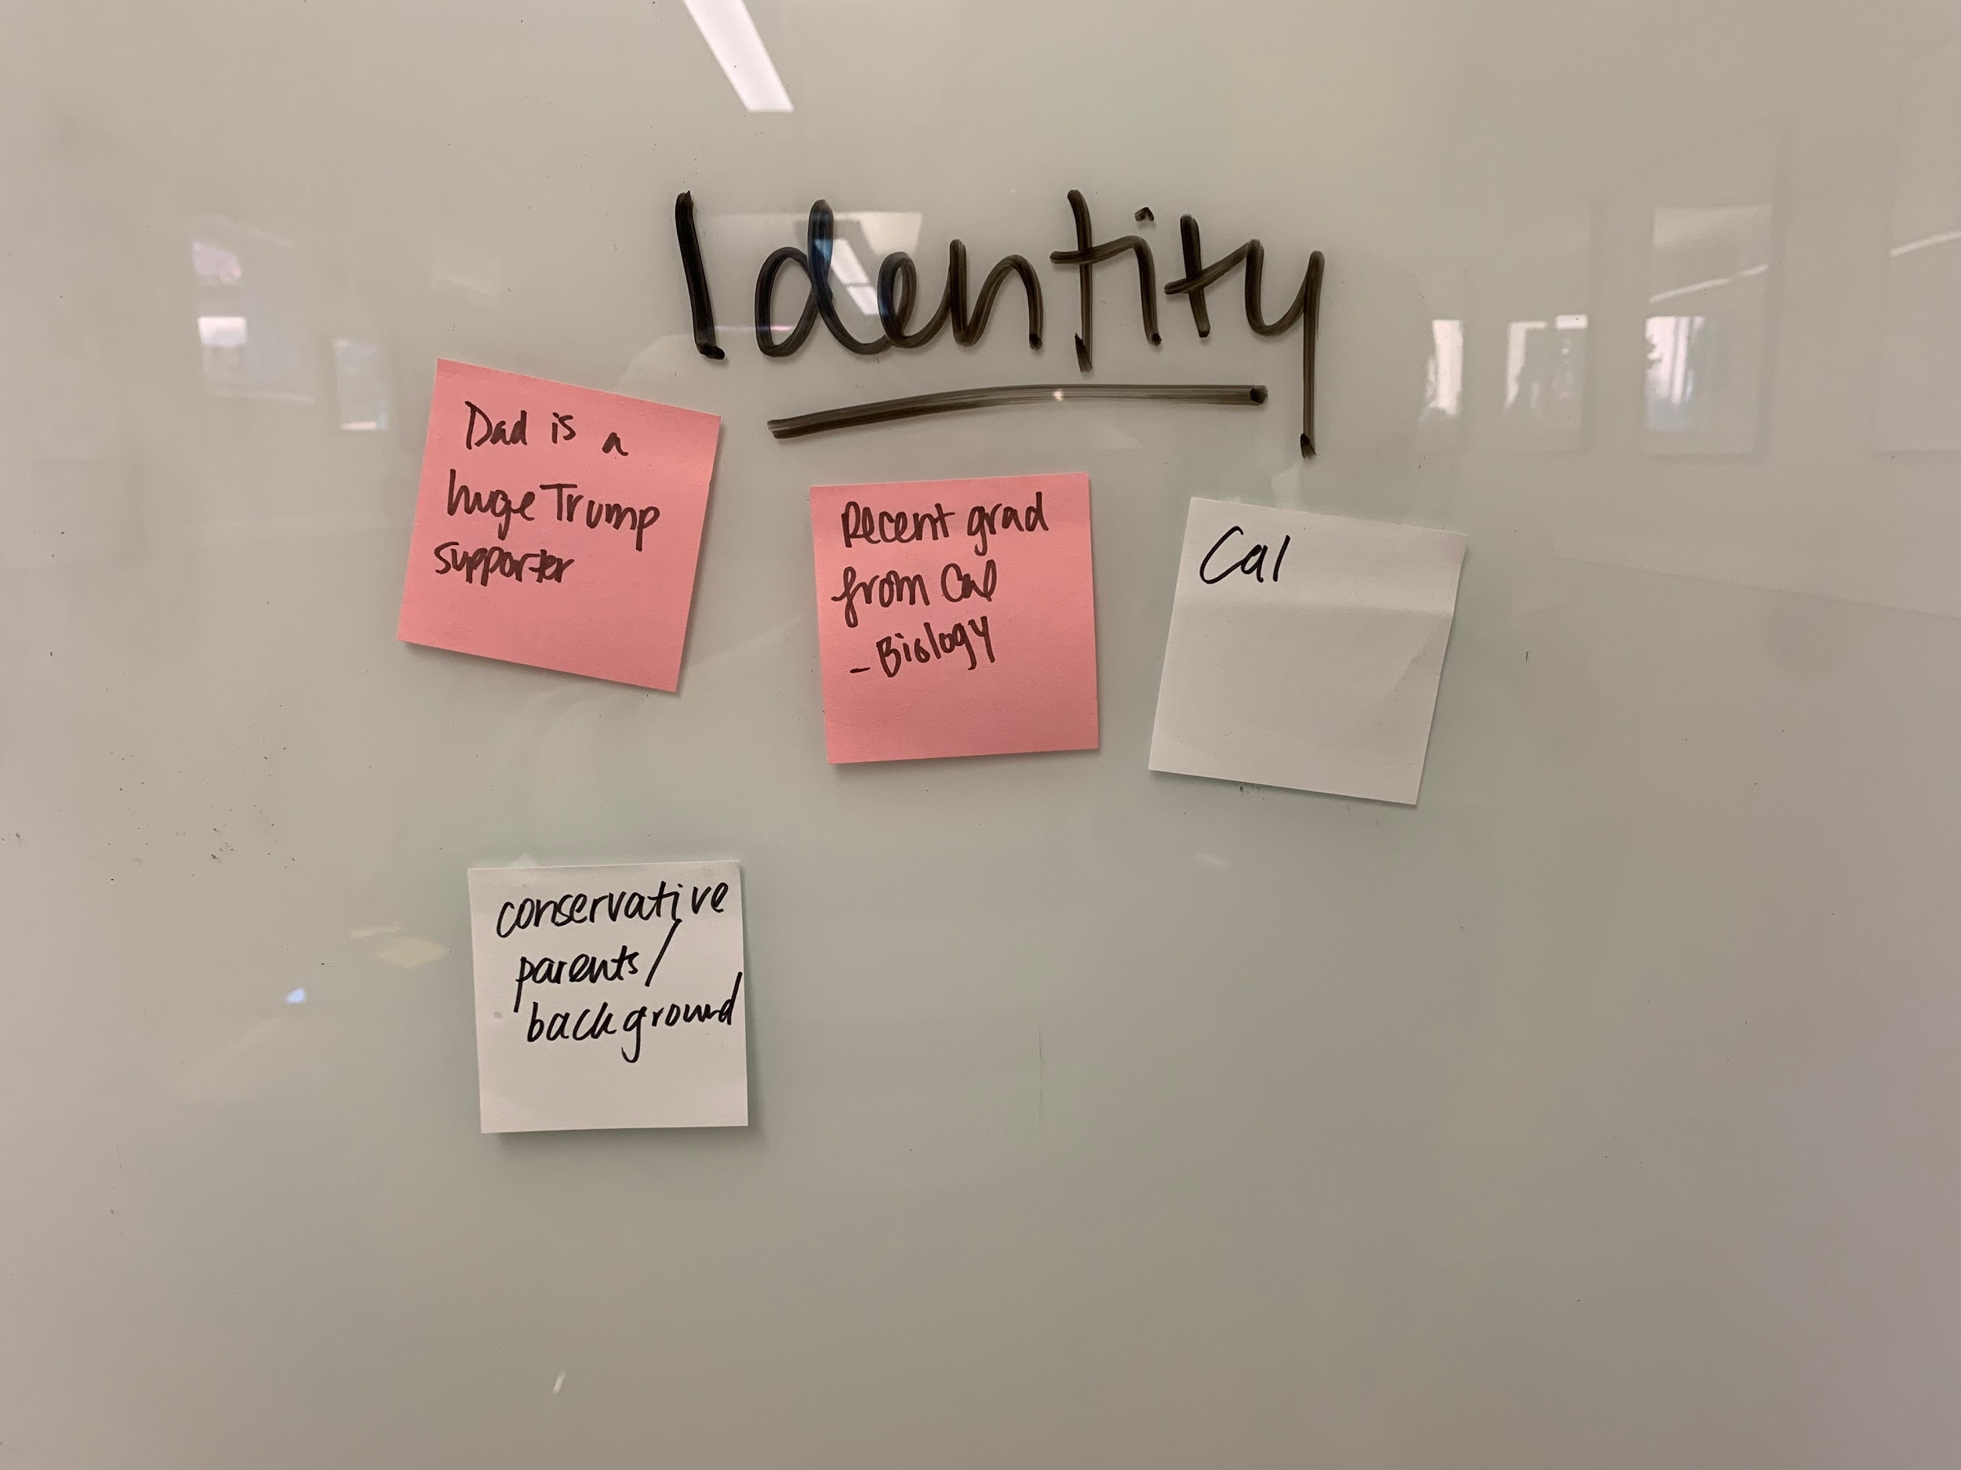
Why certain beliefs?
...whereas, where I grew up, which is in Fresno, a lot of poor people are there. And they kind of stay in this cycle of being poor, and use welfare to get by.
S
M, Recent Cal Grad
Biology
Conservative parents

Slide 11
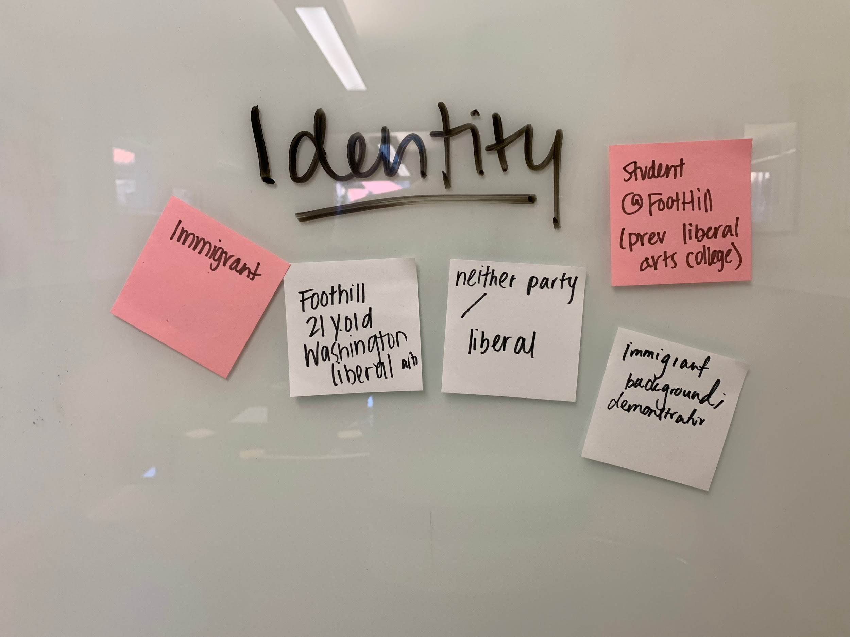
What impacted you?
“It's called Tacoma. And it has the America's biggest detention center there. So interesting. Every, every other week, we would go to the detention center and like, talk to people there and just like provide human connection.”
K
F, 21, Studying CS
Immigrant family
Activist background

Slide 12
Empathy Maps
(with highlights)

Slide 13
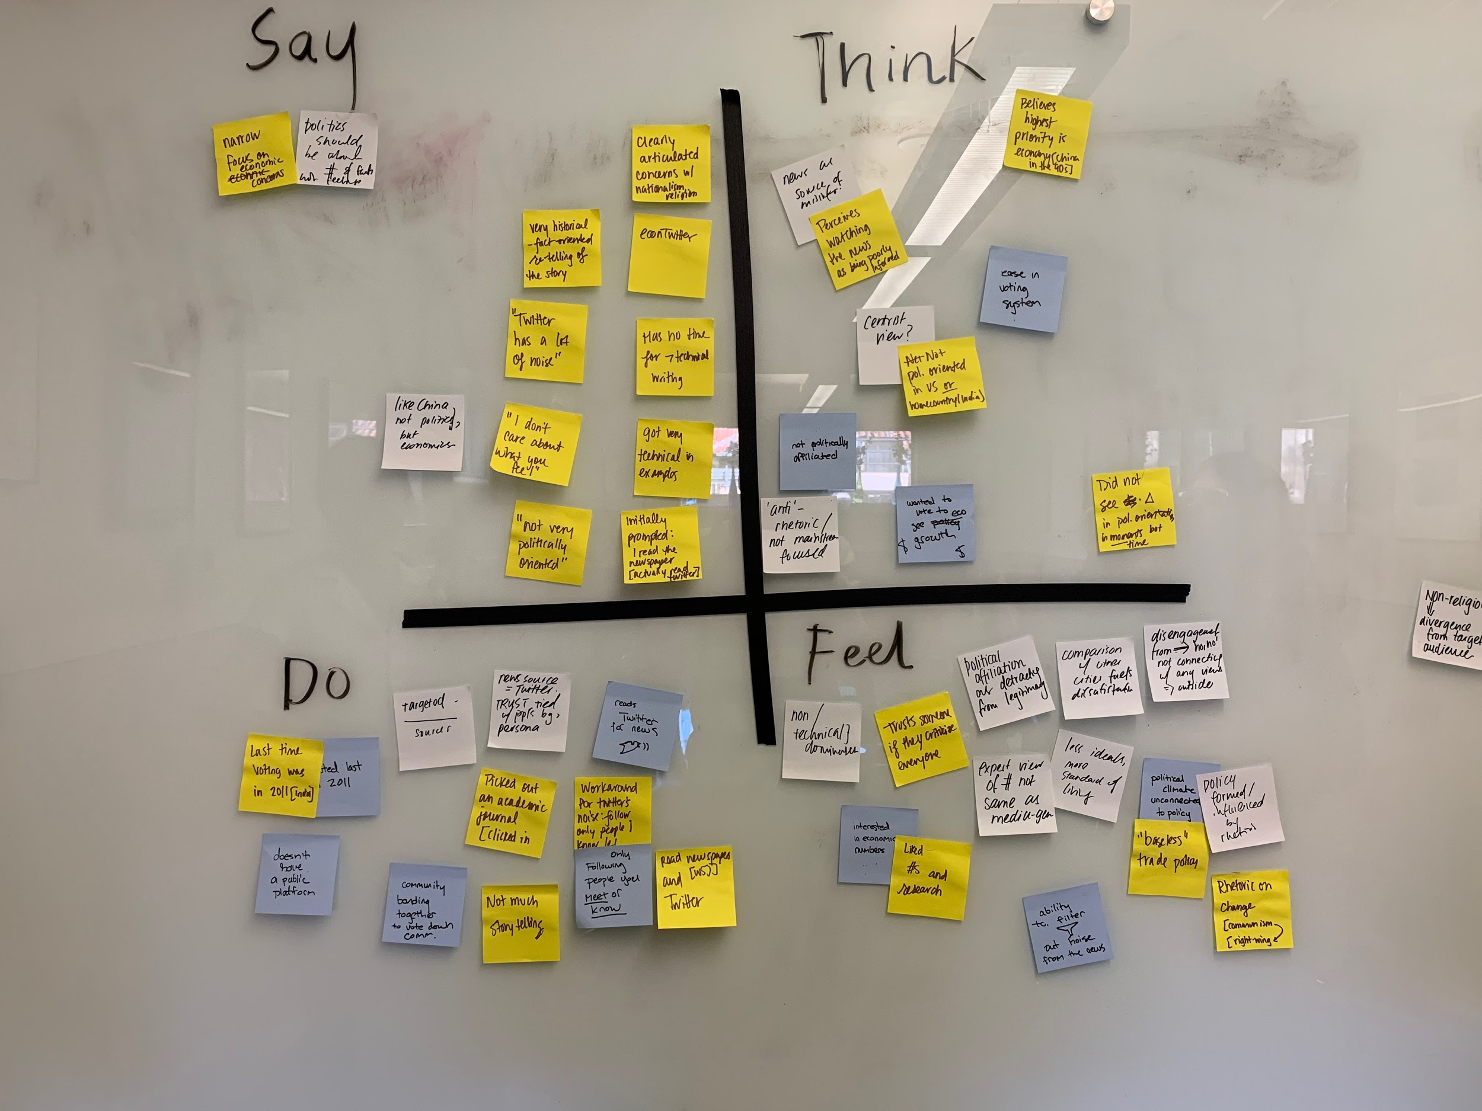
I

Slide 14
I
Twitter for news
Self interested voting

Slide 15
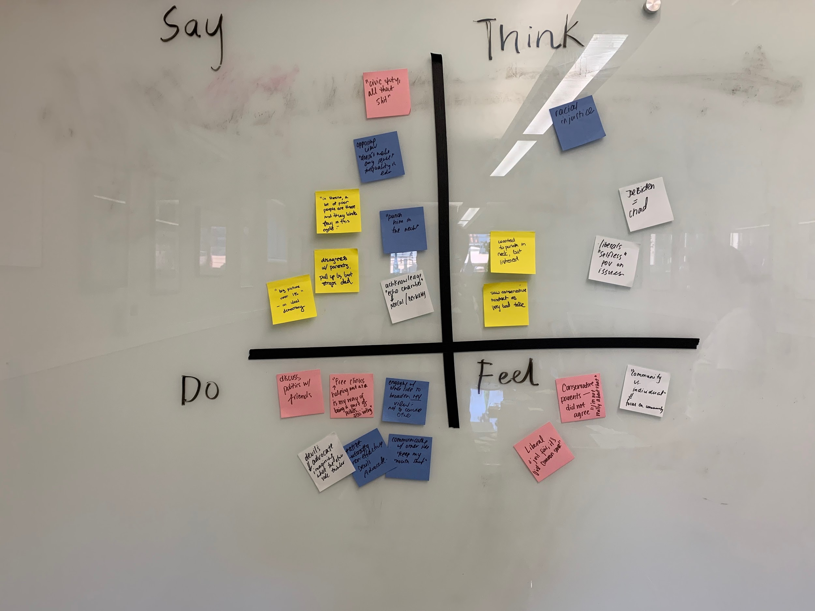
S

Slide 16
S
Difficulty/reward with engaging the other side

Slide 17
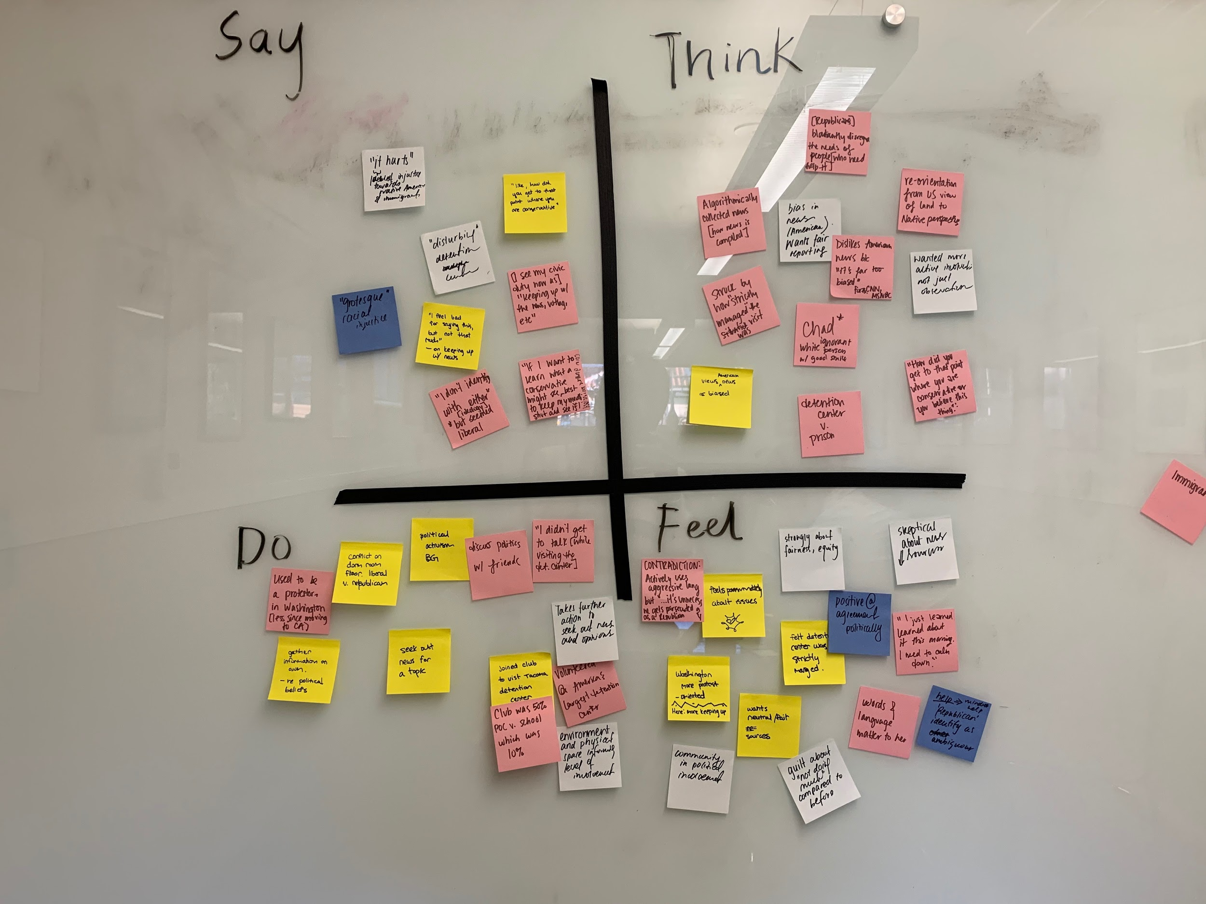
K

Slide 18
K
Engagement over news

Slide 19
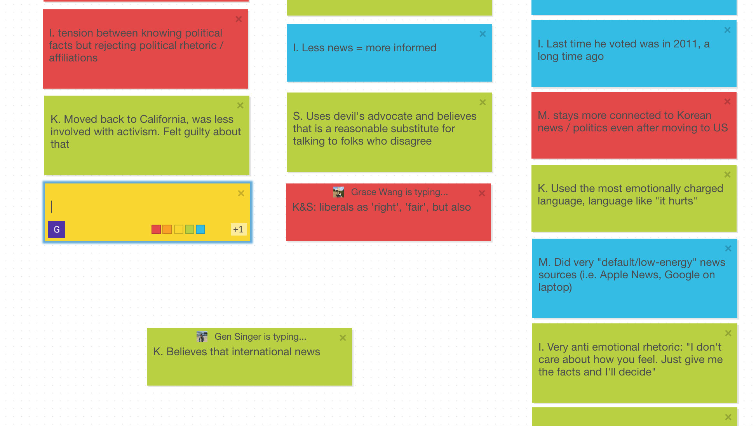
Insights, Needs, Further Questions
(less trees were harmed in this exercise)

Slide 20
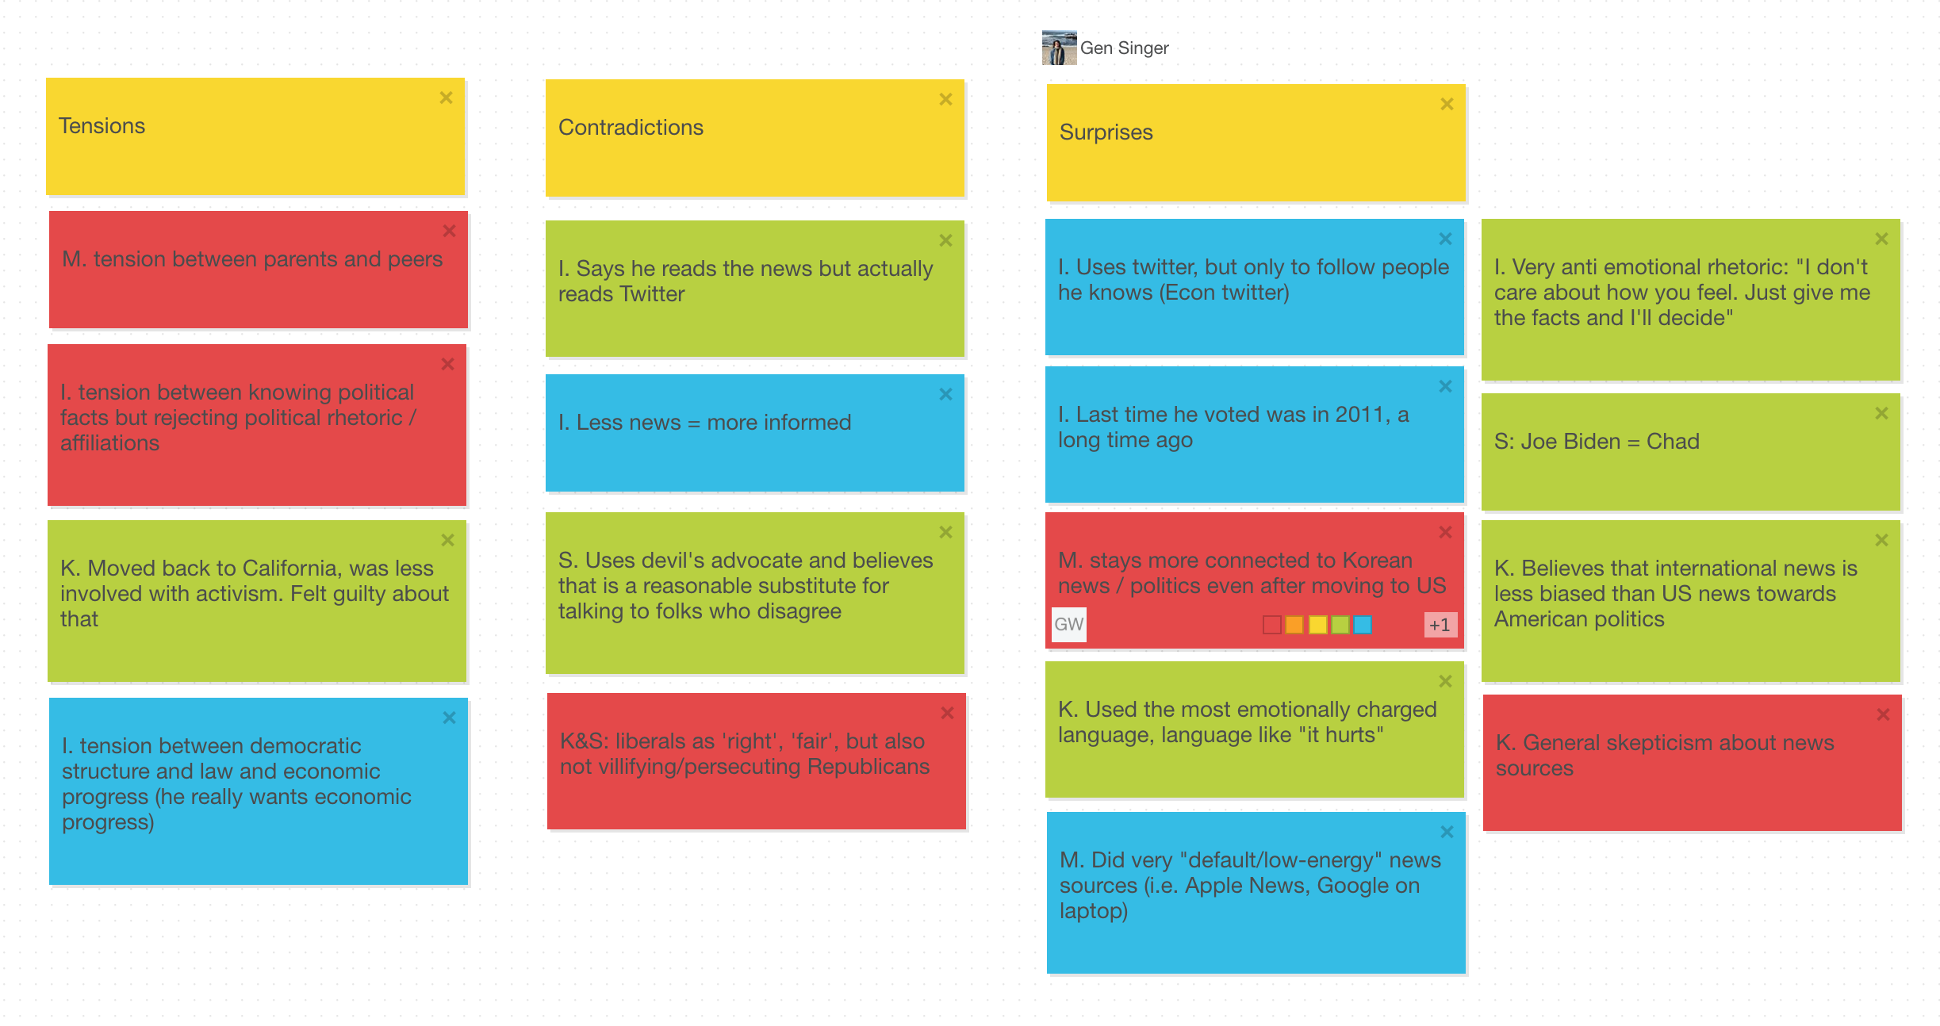

Slide 21
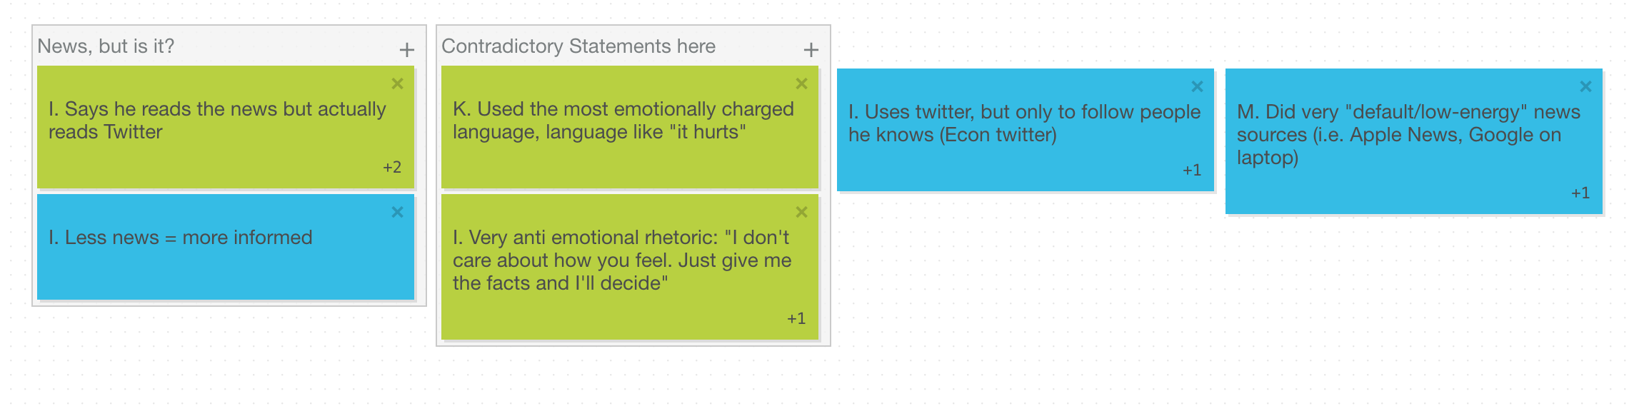

Slide 22
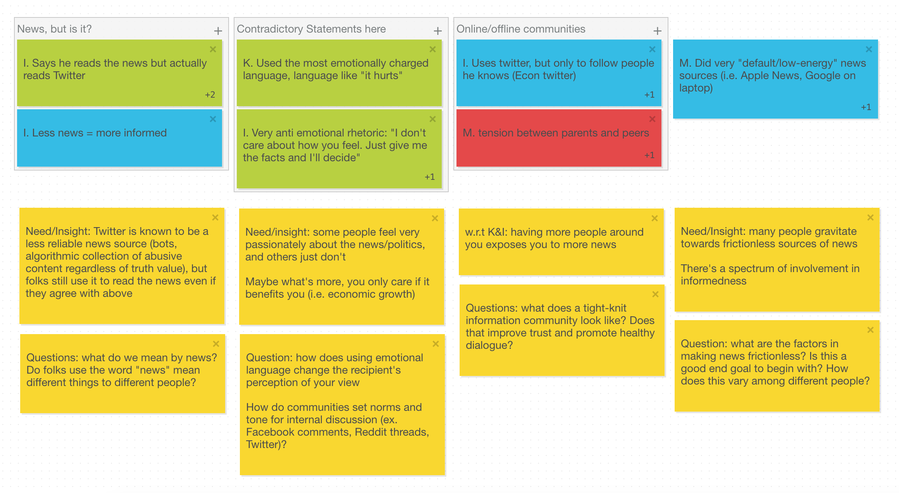

Slide 23

“Twitter has a lot of noise.”
Insight #1
Folks use social platforms not necessarily intended for news to read the news. They work around this! Need: Methods of instilling trust (and care about trust) in disseminated news
“Yeah, it’s probably the wrong [platform], but this morning I read Twitter.”
[Do you ever take a look or take into consideration what source the news is coming from?] “No, actually, I don’t.”

Slide 24
“I’m [politically] neutral.”
Insight #2
“Democratic Party gives a little more shit about [equity for all], instead of just like blatantly disregarding the needs of people who actually require them.”
Some people feel very passionately about the news and politics, and some just don't. Conversations are hard but potentially rewarding. Need: Ways of approaching discussion with unlike-minded people
“I don't care what you feel, just give me the numbers...I’ll decide what I think.”

Slide 25
“I lived in Washington for a while. And I guess like the people I was around was more of … a demonstrating crowd. And whereas being back [in California] is mostly just about...keeping up on the news, as well as making sure you vote and whatnot.”
Insight #3
Having more people around you exposes you to more news. Communities are a catalyst.
Need: Communities of people to obtain quality news and discussion
“I knew [who I follow, i.e. academics] professionally. So I knew of their work professionally. And then I found them on Twitter, and then I followed them.”

Slide 26
“[I] follow like academics, like who have been published over the years without being particularly politically affiliated”
Insight #4
Many people gravitate towards the “easiest” news they can find. Some still do care about the quality of it.
Need: Balance of quality and frictionless sources of news
“American based media [is] far too biased interest and the incentive behind them being biased, it’s far too apparent for me.”
“Well, I don't watch the news. So in that way, I’m more informed.”

Slide 27
Lingering Questions:
Can news ever be unbiased? Should it be?
To what extent is fostering connection within a like-minded network (e.g. friends) benefiting civic engagement; to what extent is it creating an echo chamber?

Slide 28
Summary
People need…
Methods of instilling trust (and care about trust) in disseminated news
Ways of approaching discussion with unlike-minded people
Communities of people to obtain quality news and discussion
Quality frictionless sources of news

Slide 29
Any questions?

Slide 30
Appendix:
Full Empathy Maps

Slide 31
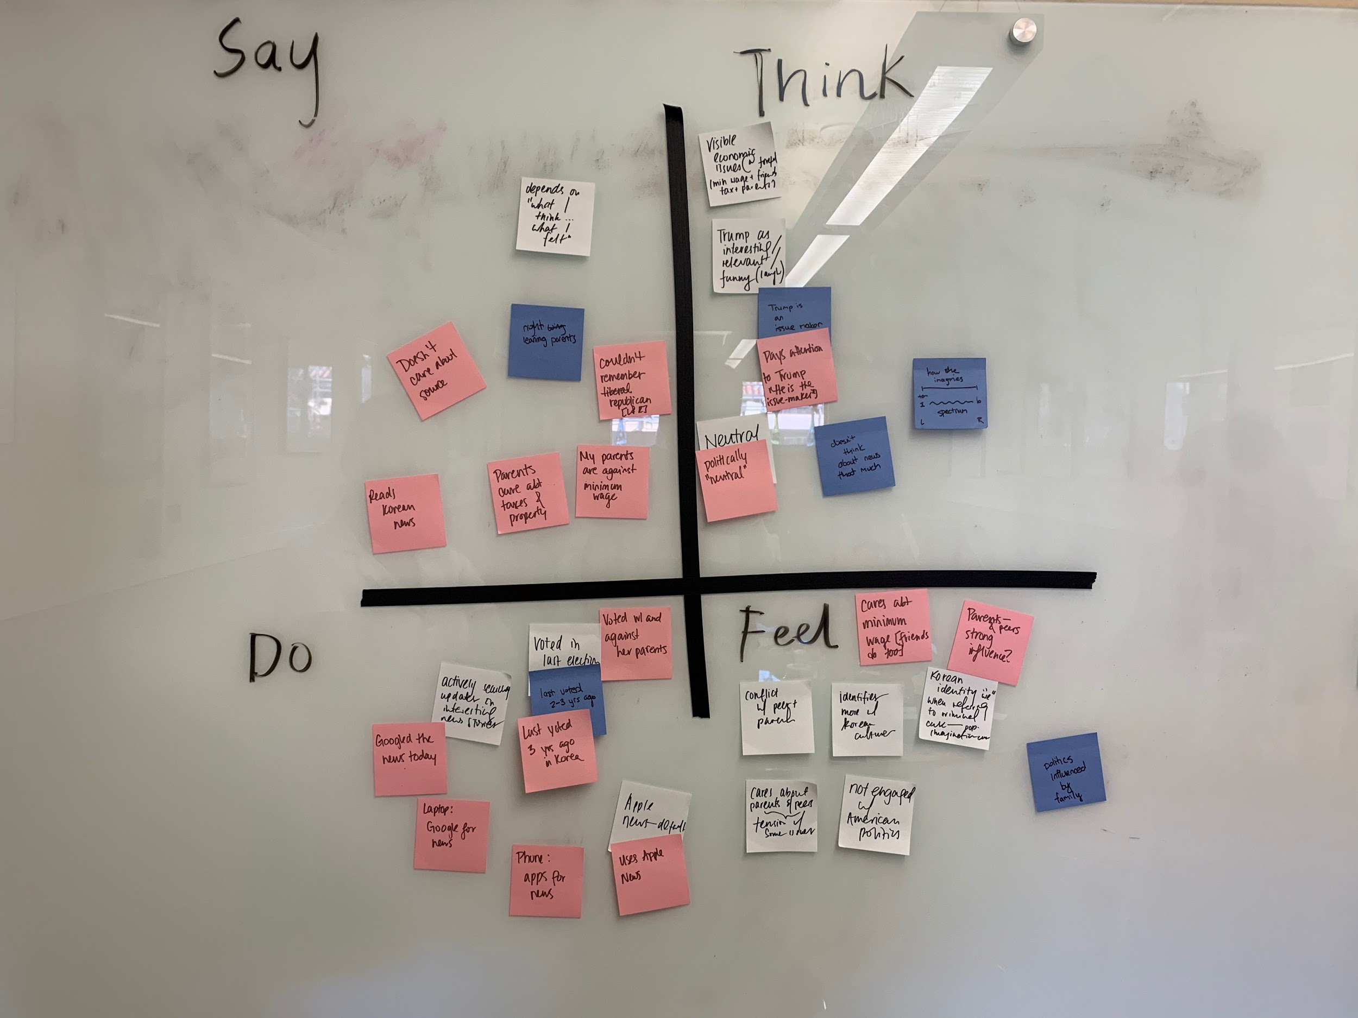
M

Slide 32
I

Slide 33
S

Slide 34
K

Slide 35
Appendix:
Stickies for Tensions, Contradictions, Surprises

Slide 38
Appendix:
Needfinding Plan & Discussion Guide

Slide 39
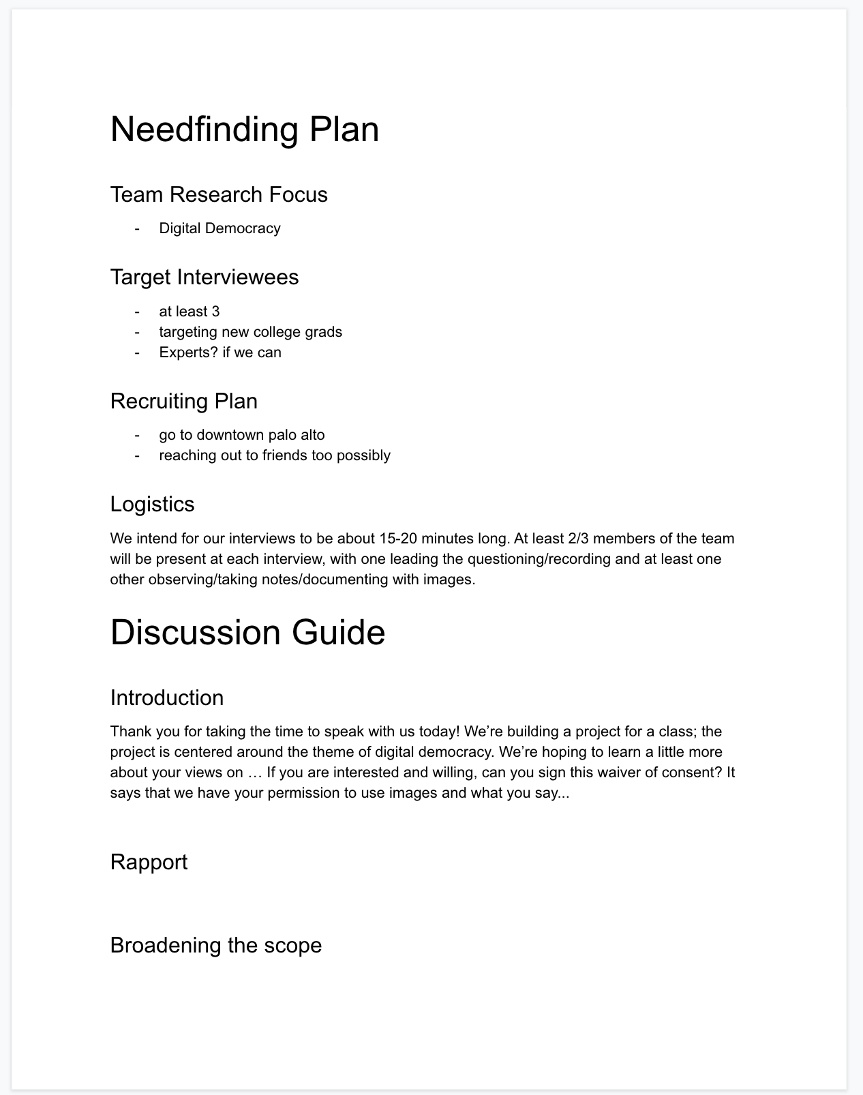

Slide 40
